Slide 1

Risk Management + Detection & Response
YOUR LOGO HERE
Note to partners: use this presentation as/is, add the content to your own branded powerpoint template, or pull the slides that are beneficial.
Audience = SME organizations
How Field Effect MDR provides cybersecurity peace of mind

Slide 2


Agenda
YOUR LOGO HERE
01 | Cybersecurity has changed, SMEs are at risk
02 | Comprehensive cybersecurity is a challenge
03 | Field Effect MDR is a new grade of cybersecurity

Slide 3
“Given the increasing frequency and severity of SME cyberattacks, it is crucial for SMEs to prioritize cybersecurity solutions to protect their businesses in the years to come.”
YOUR LOGO HERE
- Analysys Mason
Notes:
- A quote from analyst firm, Analysis Mason
- There’s an increasing frequency and severity of SME cyber attacks
- It’s crucial for small-to-midsize enterprises (SMEs) to prioritize cybersecurity
- This challenge is not going away, will be needed for years to come

Slide 4

Cybersecurity has changed,
SMEs are at risk
YOUR LOGO HERE
Notes:
We’ll take a look at the state of cybersecurity, how it’s changed, and how these changes are putting SMEs at risk.

Slide 5
SMEs are more vulnerable than ever
YOUR LOGO HERE
61%
$1mill+
67%
of SMEs were the target of a cyberattack in the last year
The average cybersecurity incident impacting SMEs
of cyber victims are attacked again within the next year
Notes:
The data shows that SMEs are more vulnerable than ever:
Incidents are becoming more common - 61% of SMEs were the target of a cyber attack in the past year
Incidents are costly – the average cybersecurity incident impacting MSPs has a total impact over 1million (fines, recovery, insurance premium increases, lost revenue, lost new business due to reputational damage)
Incidents aren’t one-and-done – 67% of cyber victims are attacked again within the next year

Slide 6

YOUR LOGO HERE
Network complexity
Hybrid work.
BYOD.
Increased cloud services.
Notes:
- shift to hybrid work environments
- widespread use of BYOD
- increased use of cloud services
Because of these, network complexity has been growing at a rapid pace.
Various operating systems with different requirements, vulnerable software that can be easily added without oversight from IT, use of public networks, all create more opportunity for attackers to exploit cybersecurity weaknesses. While making it more difficult for organizations to monitor and protect their growing threat surface.

Slide 7
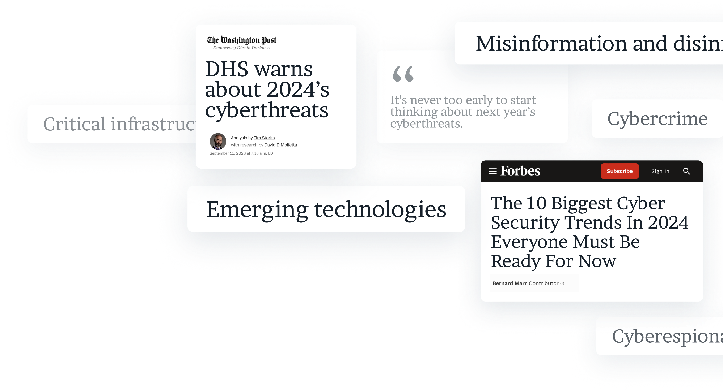
YOUR LOGO HERE
Scalability
Automated threats.
Larger target lists.
Higher attack volume.
Notes:
The influx of AI has made cybercrime more sophisticated and scalable. Attackers can automate various aspects of their attacks, targeting a greater number of people. Making the volume of attacks higher than ever.

Slide 8

YOUR LOGO HERE
Increased motivation
Monetization
easier than ever
Notes:
Through recent years, attackers have successfully monetized cybercrime.
With financial gain providing great incentive and the barriers to launching an attack so low, the motivation has never been as high.
Examples of monetization include:
- Ransom
- Selling data
- Financial redirection

Slide 9
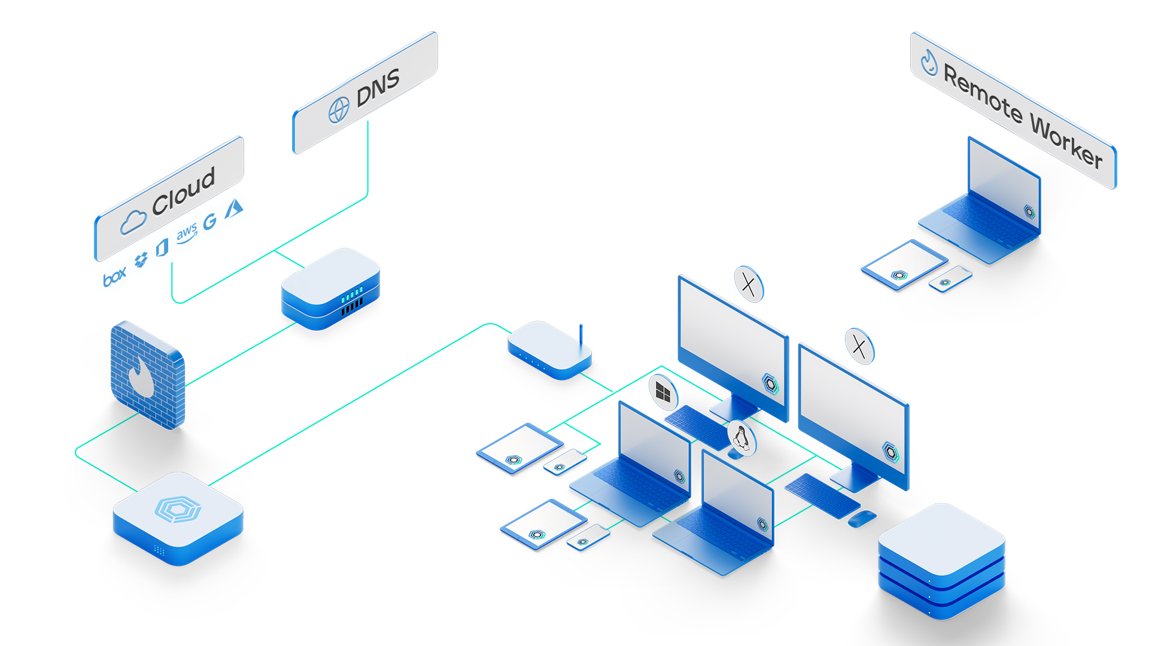

Your entire environment is a target for attackers
YOUR LOGO HERE
Top attack vectors:
Phishing
Misconfigurations
Vulnerabilities
Notes:
Your entire IT environment is a target for cyber attacks.
Most commonly, we see cyber criminals targeting via:
1. Phishing – taking advantage of busy employees and human error
2. Misconfigurations – taking advantage of misconfigurations in network setup
3. Vulnerabilities – taking advantage of known vulnerabilities (ex – unpatched operating systems)

Slide 10
Cybersecurity is a challenge
YOUR LOGO HERE
Notes:
But – getting comprehensive cybersecurity can be easier said than done. It can be a challenge.

Slide 11
Other tools are not built for today’s challenges
YOUR LOGO HERE
Incomplete
Offers a fraction of the protection needed
Reactive
Only catches threats once
they’ve infiltrated
Siloed
Multiple tools limit visibility
and escalate cost
Notes:
Yesterday’s cybersecurity is not going to protect you against today’s threats.
Most tools in the market, and there are thousands, are not built to address today’s challenges.
They are:
Incomplete: offering only a fraction of the protection needed to minimize risk
Reactive: they only catch threats once you’ve been infiltrated, and it may be too late to contain the breach
Siloed: To gain a layered security approach, many people have multiple tools that actually end up limiting visibility and escalating costs

Slide 12



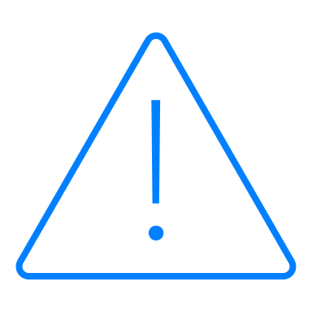

Common assumptions…
YOUR LOGO HERE
I have backups in place, I’m good
I have Anti-Virus & Firewall I’m protected
I have cyber insurance in place, my org can survive a breach.
I’ll be able to tell if something is wrong right away
Someone will manage this internally
Notes:
Common assumptions
1. I have backups in place – I can recover easily
- Backups can be incomplete
- Even if you can restore, the stolen data can be leveraged by criminals (selling, using info to further damage)
2. I have AV & Firewall – I’m protected.
- No longer sufficient security for the current threats out there
- Every major breach you’ve read about in the last four years has had AV & Firewall in place
- Working models have changed – hybrid work, remote work, distributed assets
3. I have cyber insurance – my org will survive a breach
- Cyber insurance will only cover some costs of a breach
- Won’t cover things like lost revenue due to downtime (what would three weeks with $0 revenue look like?)
- Other damage to your org, reputational damage, non-financially related
4. I’ll be able to tell if something is wrong quickly enough
- Attackers can, and often do, live on your networks for weeks or even months before making their first real move.
- They want to get as far in as possible undetected to get most impact.
5. Someone will manage this internally
- Having one staff member working off the side of their desk is not sufficient
- Need 24/7 SOC keeping your organization safe, attacks often happen on holidays, weekends, etc. when someone will not be around to notice / take action.

Slide 13
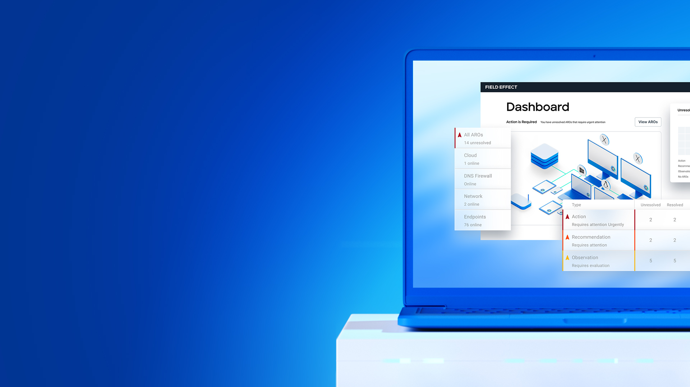
Introducing a new grade of cybersecurity for SMEs
YOUR LOGO HERE
Notes:
That’s why we’ve partnered with Fiend Effect – they built a new grade of cybersecurity for SMEs that is making a big difference for our clients.

Slide 14
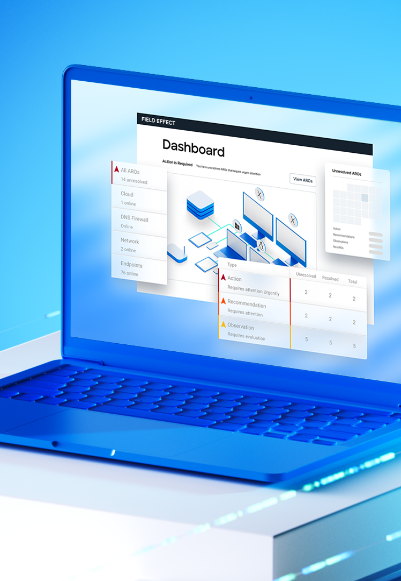
Meet
YOUR LOGO HERE
A new grade of cybersecurity that proactively protects you against even the most sophisticated threats, purpose-built for SMEs.
On a mission to be…
Accessible
World-class
Proactive
Notes:
Field Effect MDR is a new grade of cybersecurity that proactively protects you against even the most sophisticated threats.
The solution has been purpose-built for SMEs to address your unique requirements.

Slide 15
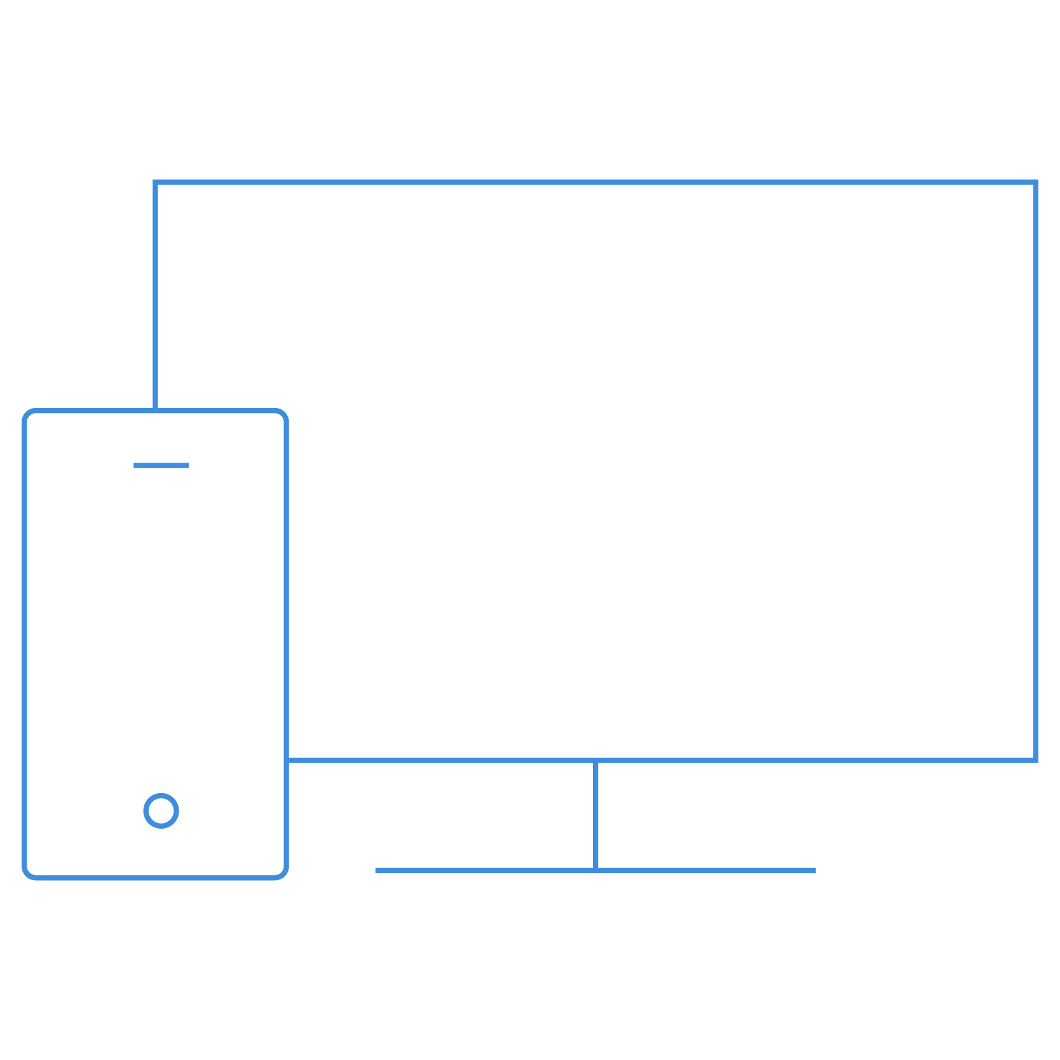

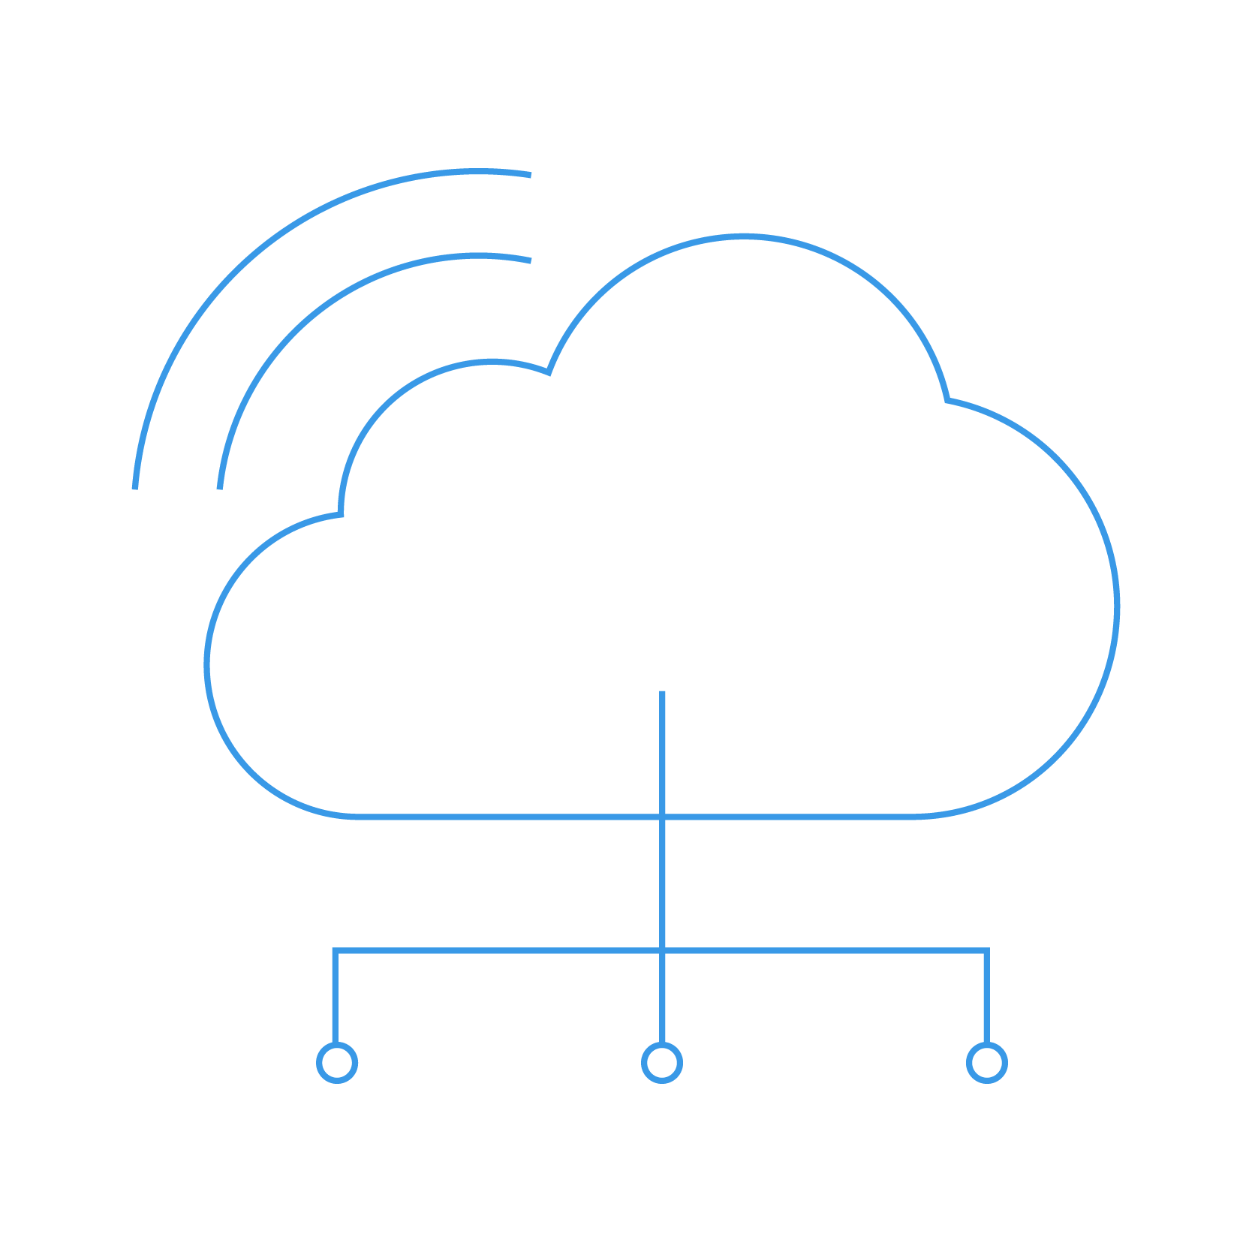
Complete visibility
YOUR LOGO HERE
Field Effect MDR provides a 360° view into your environment as well as the threats and vulnerabilities that face it.
Endpoints
+
Network
+
Cloud
Notes:
Field Effect MDR is a great solution for SMEs because it provides complete visibility into your environment – which consists of a mix of your endpoint devices, your network, and your cloud services.

Slide 16

Layered defense
YOUR LOGO HERE
A multi-layer approach to keep you secure:
Suspicious Email Analysis Service (SEAS)
Vulnerability detection
24/7 SOC
Active Response
Threat intelligence
DNS firewall
Notes:
We had talked about a layered approach to security, and Field Effect MDR has this built-in.
It offers features like:
Suspicious Email Analysis Service (known as SEAS) – which empowers your employees to send suspicious emails for analysis. You’ll be notified within minutes if there’s anything in the email to be concerned about.
Vulnerability detection – which significantly minimizes your risk of a breach with 24/7 scanning, detecting potential vulnerabilities like outdated patches, misconfigurations, external exposed assets, and more.
24/7 Security operations center (SOC) - this solution is backed 24/7 by a team of cybersecurity experts who work behind the scenes to monitor for abnormal or malicious behavior and proactively investigate early signs of potential attacks.
Active Response – automatically blocks malicious actions on the spot. For example, if malware is accidently opened on a device, it will automatically be blocked to contain the threat.
Threat intelligence - Field Effect MDR taps into the global threat intelligence community to safeguard against the latest tactics, techniques, and procedures seen globally.
DNS Firewall - Monitors and blocks connections to malicious websites to ensure safe web browsing and internet access.

Slide 17
More than threat detection…
YOUR LOGO HERE
Proactively manage and minimize risk
Put in place the tools needed to qualify for cyber insurance
Adhere to industry-standard compliance frameworks
Notes:
Field Effect MDR is more than just threat detection:
- It proactively manages and minimizes your cybersecurity risk
- It puts the right tools in place you need to qualify for cybersecurity insurance
- It helps you adhere to industry-standard compliance frameworks such as NIST, CIS Controls, and more.

Slide 18

Why?
YOUR LOGO HERE
Minimize your cybersecurity risk: continuously improve your security to minimize the chance of a breach.
Detect threats faster: benefit from quicker containment and remediation to minimize disruption to your operations.
Gain 24/7 cyber expertise: protect your environment with world-class cybersecurity experts behind the scenes.
Notes:
Why Field Effect MDR?
- Minimizes your cybersecurity risk to significantly reduce the likelihood of a breach
- Detects threats faster to minimize disruption of your organizations’ operations
- Provides 24/7 cyber expertise so you have a team of experts behind the scenes ensuring your organization is kept safe around the clock.

Slide 19

Next Steps
YOUR LOGO HERE
Assess your current cybersecurity gaps:
Attack Surface Report
Note for Partners: Offering the prospect a free Attack Surface Report from Field Effect is just an example of a next step. Please feel free to insert your own if preferred!
Notes:
What’s next?
Suggestion: Attack Surface Report – a report that shows potential gaps in security by identifying areas of your network that are visible to the public

Slide 20
YOUR LOGO HERE

